Slide 1

Creators: Flornaldine Pierre, Chris Bicknese, Robbie Darrow, Allen Telson, Alejandro Sanchez

Slide 2
Project Summary
Java-based application that provides the user with a built-in search engine that meets the user’s need to find the ideal hotel for their next trip.
Users can sort results by price (high to low or low to high)
Map feature where users will be able to interact with the map to explore hotel options.
Application will include features such as accounts to help differentiate between consumers and hotel owners or representatives that want to look and respond to reviews and feedback from consumers.
The user will be able to reserve their hotel, choose the dates of the trip and pay for the total price of the trip.

Slide 3
Functionalities
Create account: allow user to create account.
Login: allow the user to enter their username and password to login.
Search hotels: allow user to enter location information to search for hotels in that area.
View reviews: allow user to view reviews of hotels on the hotel information page.
Write reviews: allow user to write a review for a hotel.
View reservations: allows hotel owners to view all reservations for their hotel and hotel users to view their reservations.
Cancel reservation: allows users to cancel a reservation up to 24 hours after booking.
Save hotel: allow user to add hotel to a list of saved hotels.

Slide 4
Roles in Prototype Development
Back End
Robbie: JMaps API integration, Hotel text file database, Search functionality
Allen: Derby database integration, button mapping, My Account
Front End
Flora: Color scheme and style for all scenes, SOS Logo
Alex: GUI design and layout
SQA and Documentation
Chris: Oversees quality of code and documentation
Line of Code:
Total: 600,000+ Written: ~3800

Slide 5
Legacy
Dependencies
Derby Embedded library
JMaps API
JAVA 8
Challenges
GitHub utilization
Database Integration
Google Maps Integration
Software portability

Slide 6
Legacy
Issues
Hotel data is static and not completely accurate
Using a static text file
Software is not Mac compatible
JxMaps API should work with Mac but does not
Requirements
Not all original requirements made into final product
No rental cars or activities
Hotel owner can view reservations but not edit information
Photos cannot be added

Slide 7
Legacy
Lessons Learned
Communication is key
Teamwork and cohesiveness was vital to our productivity
Test as much as possible

Slide 8
Preview
VIDEO LINK

Slide 9
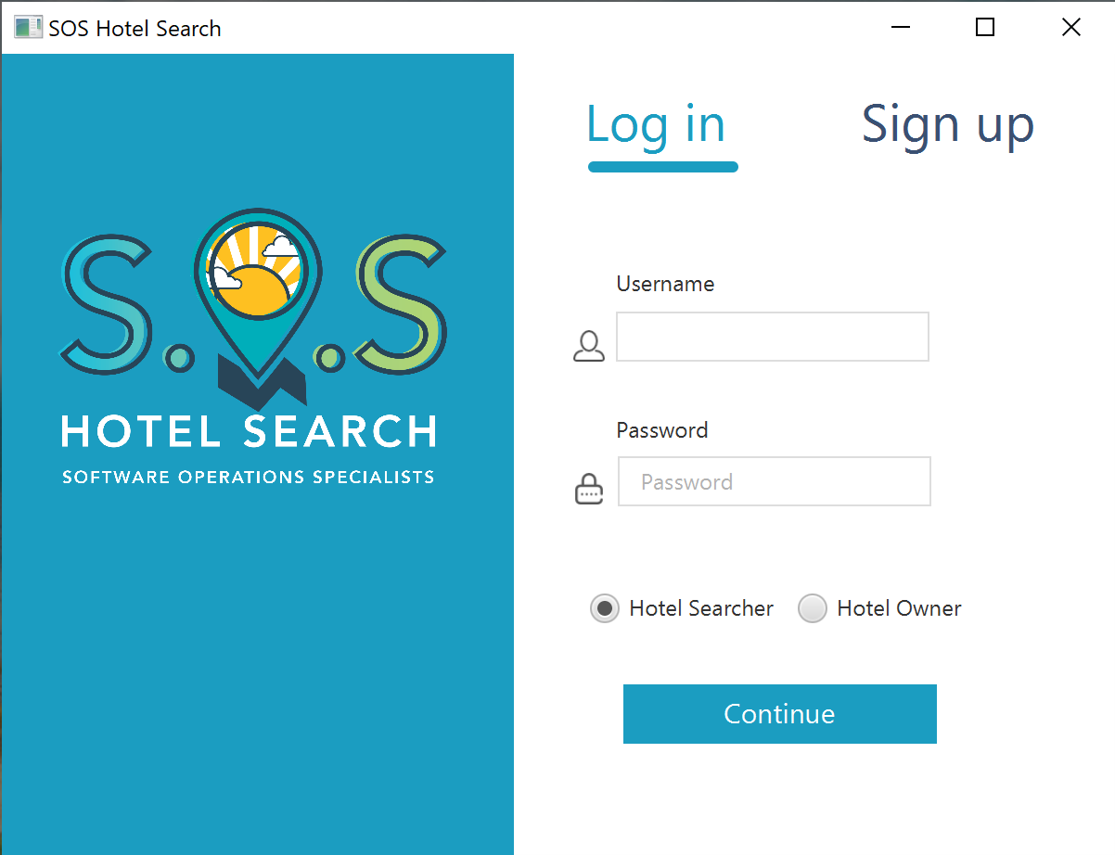
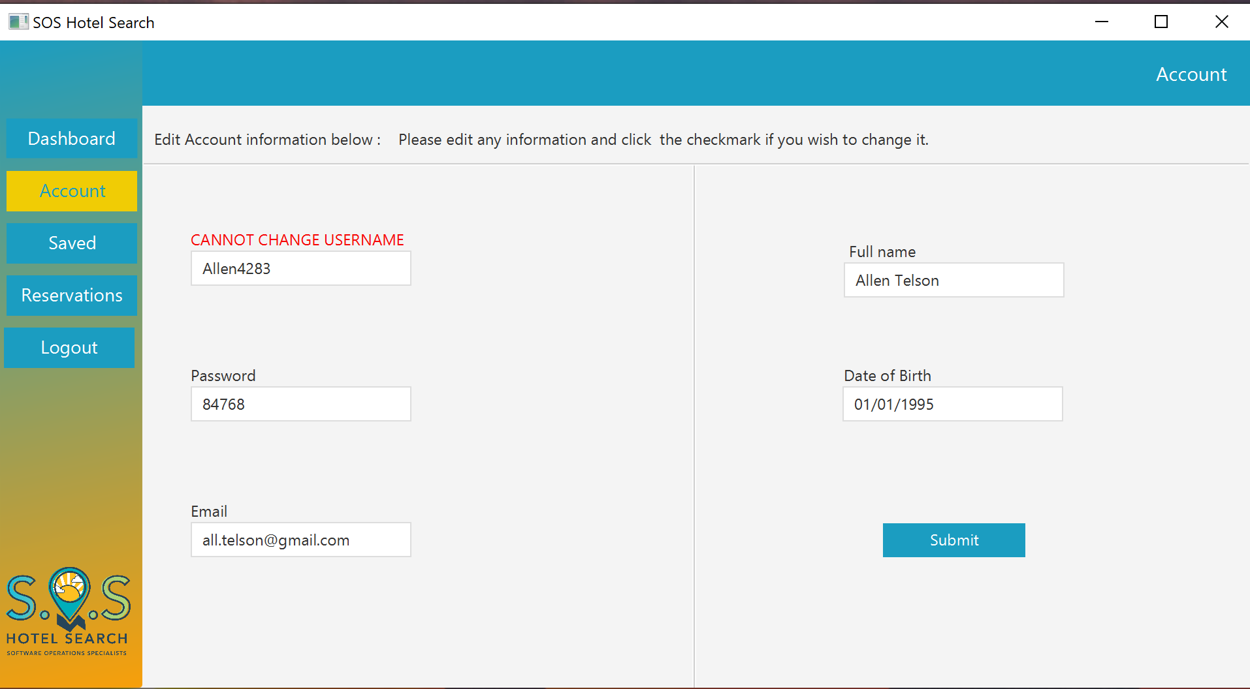
Preview
Login Scene
Account Scene

Slide 10
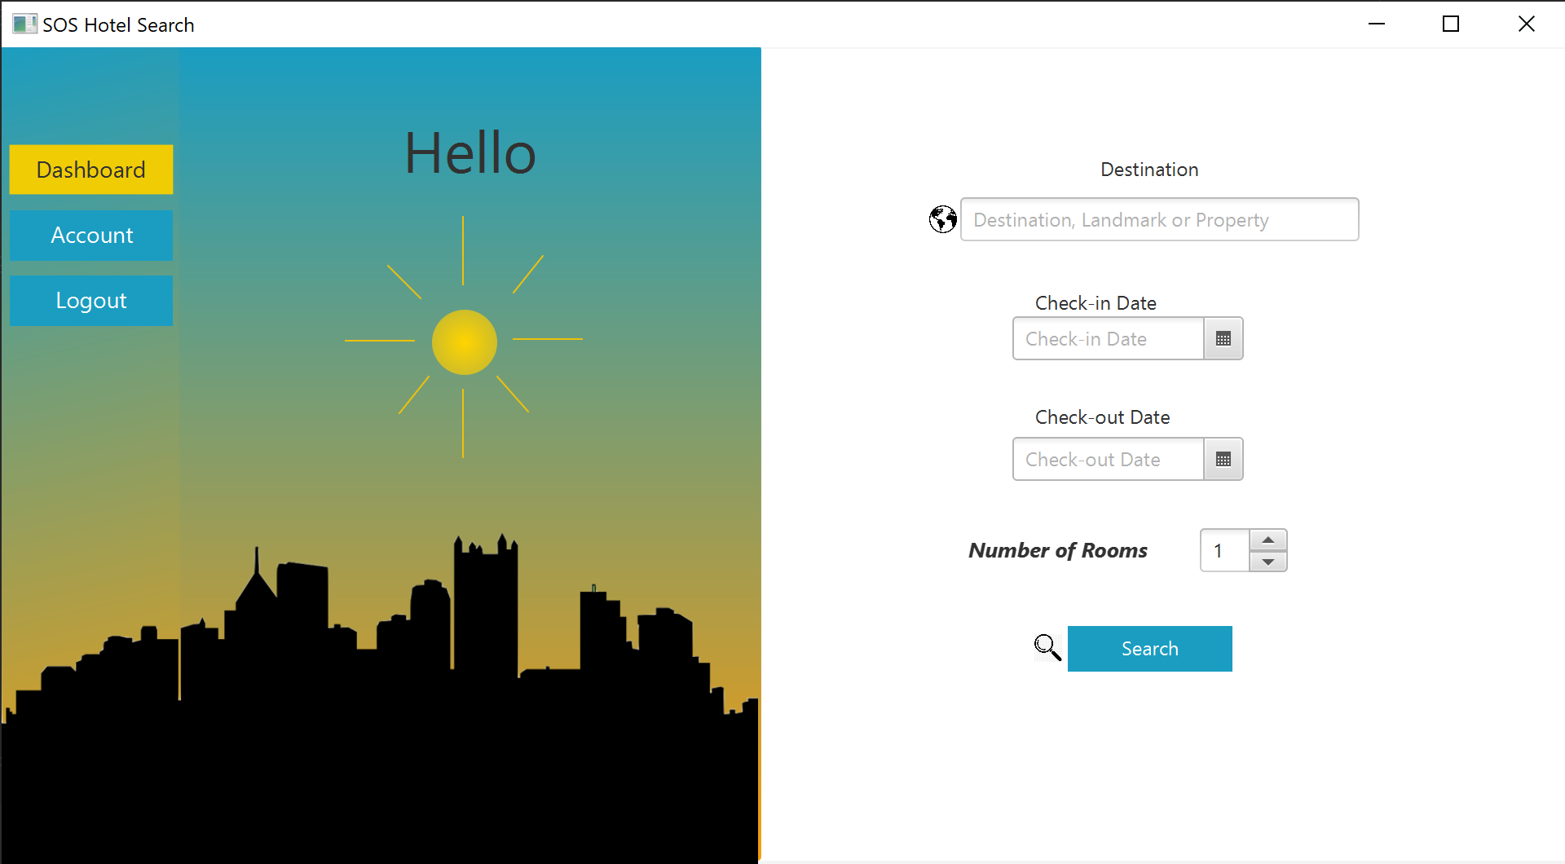
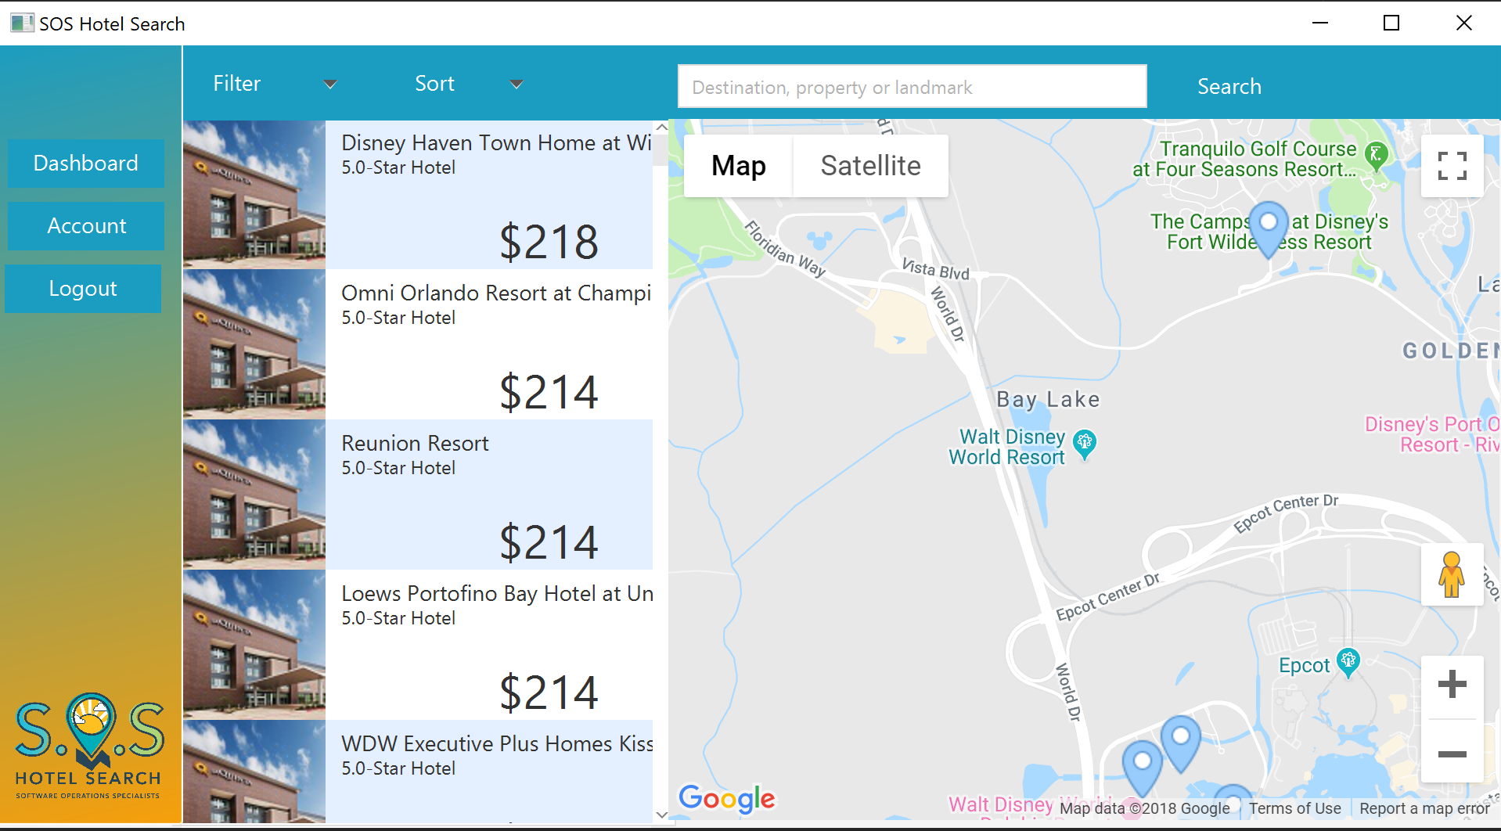
Preview
Dashboard Scene
Search Scene

Slide 11
Thank You!
Any Questions?

